Slide 1
The Next Generation Science Standards
A crash course in understanding and using NGSS in your classroom

Slide 2
Next Generation Science Standards
Key Innovations
The NGSS are not curriculum, they are endpoints of instruction.
To reach endpoints, students use the science and engineering practices, disciplinary core ideas, and crosscutting concepts to explain phenomena and/or design solutions.
For instructional materials to be aligned to the NGSS, lessons must meet the criteria of
three-dimensional learning
Notes:
The NGSS were written not as curriculum, but as end points of instruction and assessment.
In this way NGSS guides curriculum development and I want to give you a brief overview on how you can do this.
To align curriculum to the NGSS learning must be occurring in the three dimensions—SEPs, DCIs, CCCs.

Slide 3
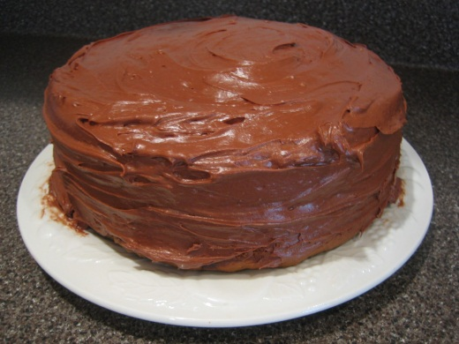
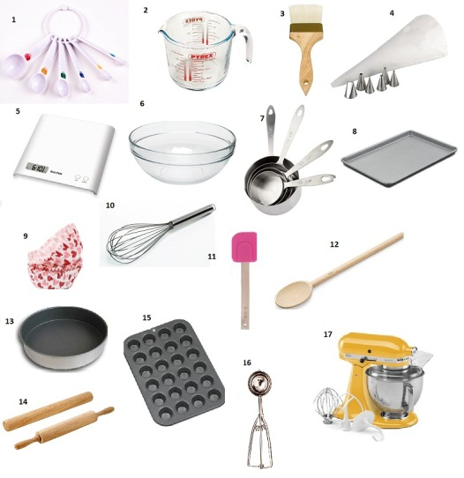
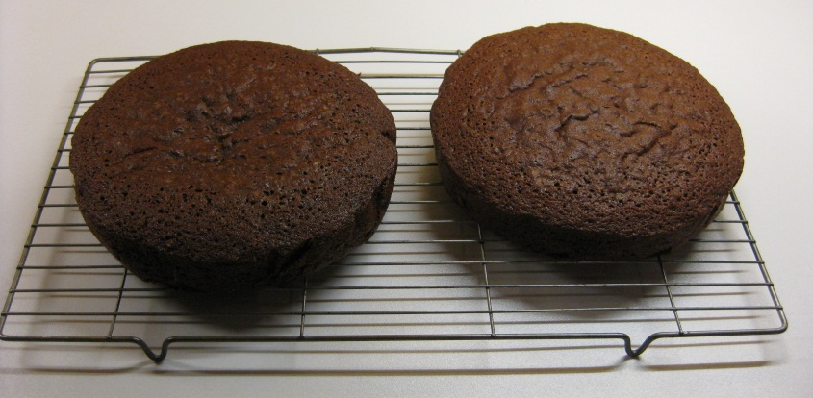
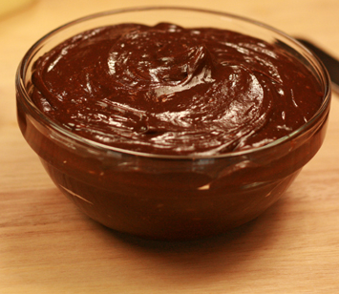
An Analogy Between the
NGSS and a Cake
Baking a Cake
(Performance Expectation)
Kitchen Tools & Techniques
(Science & Engineering Practices)
Cake
(Disciplinary Core Ideas)
Frosting
(Crosscutting Concepts)
Notes:
You cannot get a cake with out all the components, just as you cannot align curriculum to the NGSS with out the SEPs, DCIs, and CCCs.

Slide 4

A Framework for K–12
Science Education
The Three Dimensions
Scientific and engineering practices
Crosscutting concepts
Disciplinary core ideas
Notes:
These were based on the K-12 Science Education Framework that was developed by the National Academy of Sciences in 2011.

Slide 5
Disciplinary Core Ideas (DCIs)
Life Science | Physical Science
LS1: From Molecules to Organisms: Structures and Processes LS2: Ecosystems: Interactions, Energy, and Dynamics LS3: Heredity: Inheritance and Variation of Traits LS4: Biological Evolution: Unity and Diversity | PS1: Matter and Its Interactions PS2: Motion and Stability: Forces and Interactions PS3: Energy PS4: Waves and Their Applications in Technologies for Information Transfer
Earth & Space Science | Engineering & Technology
ESS1: Earth’s Place in the Universe ESS2: Earth’s Systems ESS3: Earth and Human Activity | ETS1: Engineering Design
Notes:
If you are new to NGSS these are probably what you are most familiar with.

Slide 6
SCIENCE!
PS
PS1
PS2
ETS
ETS1
LS
ESS
PS3
PS4
LS1
LS2
LS3
LS4
ESS1
ESS2
ESS3
ETS2
PS1.A
PS1.B
PS1.C
PS2.A
PS2.B
PS2.C
PS3.A
PS3.B
PS3.C
PS3.D
PS4.A
PS4.B
PS4.C
LS1.A
LS1.B
LS1.C
LS1.D
LS2.A
LS2.B
LS2.C
LS2.D
LS3.A
LS3.B
LS4.A
LS4.B
LS4.C
LS4.D
ESS1.A
ESS1.B
ESS1.C
ESS2.A
ESS2.B
ESS2.C
ESS2.D
ESS2.E
ESS3.A
ESS3.B
ESS3.C
ESS3.D
ETS1.A
ETS1.B
ETS1.C
ETS2.A
ETS2.B

Slide 7
SCIENCE!
Physical Sciences
PS1
PS2
Engineering, Technology, and Applications of Science
ETS1
Life Sciences
Earth and Space Sciences
PS3
PS4
LS1
LS2
LS3
LS4
ESS1
ESS2
ESS3
ETS2
PS1.A
PS1.B
PS1.C
PS2.A
PS2.B
PS2.C
PS3.A
PS3.B
PS3.C
PS3.D
PS4.A
PS4.B
PS4.C
LS1.A
LS1.B
LS1.C
LS1.D
LS2.A
LS2.B
LS2.C
LS2.D
LS3.A
LS3.B
LS4.A
LS4.B
LS4.C
LS4.D
ESS1.A
ESS1.B
ESS1.C
ESS2.A
ESS2.B
ESS2.C
ESS2.D
ESS2.E
ESS3.A
ESS3.B
ESS3.C
ESS3.D
ETS1.A
ETS1.B
ETS1.C
ETS2.A
ETS2.B
Disciplines

Slide 8
SCIENCE!
PS
PS1
PS2
ETS
ETS1
LS
ESS
PS3
PS4
LS1
LS2
LS3
LS4
ESS1
ESS2
ESS3
ETS2
PS1.A
PS1.B
PS1.C
PS2.A
PS2.B
PS2.C
PS3.A
PS3.B
PS3.C
PS3.D
PS4.A
PS4.B
PS4.C
LS1.A
LS1.B
LS1.C
LS1.D
LS2.A
LS2.B
LS2.C
LS2.D
LS3.A
LS3.B
LS4.A
LS4.B
LS4.C
LS4.D
ESS1.A
ESS1.B
ESS1.C
ESS2.A
ESS2.B
ESS2.C
ESS2.D
ESS2.E
ESS3.A
ESS3.B
ESS3.C
ESS3.D
ETS1.A
ETS1.B
ETS1.C
ETS2.A
ETS2.B
Disciplines

Slide 9
SCIENCE!
PS
PS1
PS2
ETS
ETS1
LS
ESS
PS3
PS4
LS1
LS2
LS3
LS4
ESS1
ESS2
ESS3
ETS2
PS1.A
PS1.B
PS1.C
PS2.A
PS2.B
PS2.C
PS3.A
PS3.B
PS3.C
PS3.D
PS4.A
PS4.B
PS4.C
LS1.A
LS1.B
LS1.C
LS1.D
LS2.A
LS2.B
LS2.C
LS2.D
LS3.A
LS3.B
LS4.A
LS4.B
LS4.C
LS4.D
ESS1.A
ESS1.B
ESS1.C
ESS2.A
ESS2.B
ESS2.C
ESS2.D
ESS2.E
ESS3.A
ESS3.B
ESS3.C
ESS3.D
ETS1.A
ETS1.B
ETS1.C
ETS2.A
ETS2.B
Disciplinary Core Ideas
DCIs

Slide 10
SCIENCE!
PS
PS1
PS2
ETS
ETS1
LS
ESS
PS3
PS4
LS1
LS2
LS3
LS4
ESS1
ESS2
ESS3
ETS2
PS1.A
PS1.B
PS1.C
PS2.A
PS2.B
PS2.C
PS3.A
PS3.B
PS3.C
PS3.D
PS4.A
PS4.B
PS4.C
LS1.A
LS1.B
LS1.C
LS1.D
LS2.A
LS2.B
LS2.C
LS2.D
LS3.A
LS3.B
LS4.A
LS4.B
LS4.C
LS4.D
ESS1.A
ESS1.B
ESS1.C
ESS2.A
ESS2.B
ESS2.C
ESS2.D
ESS2.E
ESS3.A
ESS3.B
ESS3.C
ESS3.D
ETS1.A
ETS1.B
ETS1.C
ETS2.A
ETS2.B
Component Ideas
Notes:
Look out how DCI build over grade levels

Slide 11
Disciplinary Core Ideas (DCIs)
Core ideas should:
Have broad importance across multiple sciences or engineering disciplines or be a key organizing principle of a single discipline
Provide a key tool for understanding or investigating more complex ideas and solving problems.
Relate to the interests and life experiences of students or be connected to societal or personal concerns
Be teachable and learnable over multiple grades at increasing levels of depth and sophistication
National Research Council (2012). A framework for K-12 science education: Practices, crosscutting concepts, and core ideas. Washington DC: The National Academies Press
Notes:
Look out how DCI build over grade levels

Slide 12
Science and Engineering
Practices (SEPs)
Asking questions (for science)
and defining problems (for engineering)
Developing and using models
Planning and carrying out investigations
Analyzing and interpreting data
Using mathematics and computational thinking
Constructing explanations (for science)
and designing solutions (for engineering)
Engaging in argument from evidence
Obtaining, evaluating, and communicating
information
Notes:
We will talk about these in greater detail, but your students are most likely doing these already in your classroom.

Slide 13
Crosscutting Concepts (CCCs)
Patterns
Cause and effect: Mechanism and explanation
Scale, proportion, and quantity
Systems and system models
Energy and matter: Flows, cycles, and conservation
Structure and function
Stability and change
Notes:
CCCs are what I consider the most unique element of the NGSS because they link different domains of science together which is not how science is normally taught (silos).

Slide 14

The Elements of the Three Dimensions

Slide 15
The Elements of the
Dimensions
Elements are the grade-level-specific bullet points
that are displayed in the SEP, DCI, and CCC sections
of the foundation box. They guide learning at specific grade levels.
MS-PS1 Matter and Its Interactions
Students who demonstrate understanding can: MS-PS1-5. Develop and use a model to describe how the total number of atoms does not change in a chemical reaction and thus mass is conserved. [Clarification Statement: Emphasis is on law of conservation of matter and on physical models or drawings, including digital forms, that represent atoms.] [Assessment Boundary: Assessment does not include the use of atomic masses, balancing symbolic equations, or intermolecular forces.]
The performance expectations above were developed using the following elements from the NRC document A Framework for K-12 Science Education:
Science and Engineering Practices | Disciplinary Core Ideas | Crosscutting Concepts
Developing and Using Models Modeling in 6–8 builds on K–5 experiences and progresses to developing, using, and revising models to support explanations, describe, test, and predict more abstract phenomena and design systems. Develop a model to describe unobservable mechanisms. (MS-PS1-5) | PS1.B: Chemical Reactions Substances react chemically in characteristic ways. In a chemical process, the atoms that make up the original substances are regrouped into different molecules, and these new substances have different properties from those of the reactants. (MS-PS1-2), (MS-PS1-3), ( MS-PS1-5) The total number of each type of atom is conserved, and thus the mass does not change. (MS-PS1-5) | Energy and Matter Matter is conserved because atoms are conserved in physical and chemical processes. (MS-PS1-5)
Notes:
I think the elements are the most helpful part of the NGSS because they provide a more in-depth explanation of what students should be doing for that particular dimension of the Performance Expectation. There can be multiple elements for a dimension.
For more detail on the elements you can look at the appendices which I have included in on your flash drive.

Slide 16
The Elements of the
Dimensions
Elements are the grade-level-specific bullet points
that are displayed in the SEP, DCI, and CCC sections
of the foundation box. They guide learning at specific grade levels.
MS-PS1 Matter and Its Interactions
Students who demonstrate understanding can: MS-PS1-5. Develop and use a model to describe how the total number of atoms does not change in a chemical reaction and thus mass is conserved. [Clarification Statement: Examples of reactions could include burning sugar or steel wool, fat reacting with sodium hydroxide, and mixing zinc with hydrogen chloride.] [Assessment Boundary: Assessment is limited to analysis of the following properties: density, melting point, boiling point, solubility, flammability, and odor.]
The performance expectations above were developed using the following elements from the NRC document A Framework for K-12 Science Education:
Science and Engineering Practices | Disciplinary Core Ideas | Crosscutting Concepts
Developing and Using Models Modeling in 6–8 builds on K–5 and progresses to developing, using and revising models to support explanations, describe, test, and predict more abstract phenomena and design systems. Develop a model to describe unobservable mechanisms. (MS-PS1-5) | PS1.B: Chemical Reactions Substances react chemically in characteristic ways. In a chemical process, the atoms that make up the original substances are regrouped into different molecules, and these new substances have different properties from those of the reactants. (MS-PS1-2), ( MS-PS1-5) The total number of each type of atom is conserved, and thus the mass does not change. (MS-PS1-5) | Energy and Matter Matter is conserved because atoms are conserved in physical and chemical processes. (MS-PS1-5)
Notes:
The elements are the highlighted bullet points.

Slide 17
Why Use the Elements of the Three Dimensions
The NGSS identify the capabilities students
should demonstrate when using each dimension
by the end of each grade band in the elements of that dimension.
The elements should be used when gathering evidence of students using the dimensions to make sense of phenomena or develop solutions to problems.
Notes:
To evaluate whether or not students are engaged in three dimensional learning you look for evidence that the students are using the elements of each dimension together to explain phenomena or design solutions to problems.

Slide 18
Save the Penguins

Slide 19
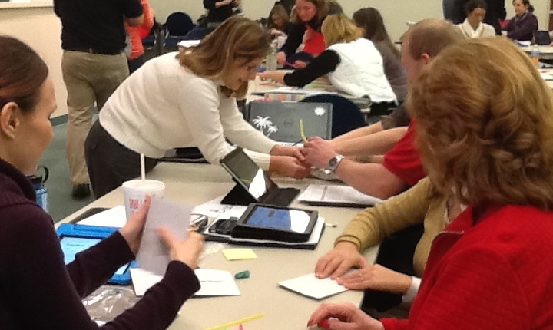
Looking for Evidence of 3D Learning

Slide 20
Engage: Save The Penguins
Notes:
https://www.whoi.edu/page.do?pid=7545&cid=80453&tid=7842

Slide 21
Save the Penguins Part 1:
Task: You are a team of engineers assigned to collaboratively develop a penguin habitat that will keep them cool.
  What solution do you propose?
  How do you justify your solution?

Slide 22
Reading the Standards

Slide 23
Inside the NGSS Box
Notes:
When looking at a set of performance expectations it can be a little overwhelming to look out because there is a lot of information being displayed.

Slide 24
Inside the NGSS Box
Title
The title for a set of performance expectations is not necessarily unique and may be reused at several different grade levels.
Performance Expectations
A statement that combines practices, core ideas, and crosscutting concepts to describe how students can show what they have learned
Clarification Statement
A statement that supplies examples or additional clarification to the performance expectation
What Is Assessed
A collection of several performance expectations describing what students should be able to do at
the end of instruction
Assessment Boundary
A statement that provides guidance about the scope of the performance expectation at a particular grade level
Engineering Connection (*)
An asterisk indicates that a performance expectation integrates traditional science content with engineering through a practice or core idea.
Science and Engineering Practices
Activities that scientists and engineers engage in to either understand the world or solve a problem
Foundation Box
The practices, disciplinary core ideas, and crosscutting concepts from the Framework for K–12 Science Education
that were used to form the performance expectations
Disciplinary Core Ideas
Concepts in science and engineering that have broad importance within and across disciplines, as well as relevance in people’s lives
Crosscutting Concepts
Ideas, such as patterns and cause and effect, that are not specific to any one discipline but cut across them all
Connections to Engineering, Technology and Applications of Science
These connections are drawn from the disciplinary core ideas for engineering, technology, and applications of science in the Framework.
Connection Box
Places elsewhere in the NGSS or in the Common Core State Standards that have connections to the performance expectations
on this page
Connections to Nature of Science
Connections are listed in either the practices or the crosscutting concepts sections of the foundation box.
Codes for Performance Expectations
Every performance expectation has a unique code, and items in the foundation box and connection box reference this code. In the connections to Common Core, italics indicate a potential connection rather than a required prerequisite connection.
Notes:
This is an explanation of everything being displayed on the last slide. The good news is once you know how to read NGSS performance expectations it gets easier to use them more intentionally.

Slide 25
Inside the NGSS Box
Title
The title for a set of performance expectations is not necessarily unique and may be reused at several different grade levels.
What Is Assessed
A collection of several performance expectations describing what students should be able to do at
the end of instruction
Foundation Box
The practices, disciplinary core ideas, and crosscutting concepts from the Framework for K–12 Science Education
that were used to form the performance expectations
Connection Box
Places elsewhere in NGSS or in the Common Core State Standards that have connections to the performance expectations
on this page
Notes:
What is Assessed: Performance Expectations
Foundation Box: Contains the three dimensions
Connection Box: Highlights connections between PEs and other parts of NGSS and Common Core State Standards

Slide 26
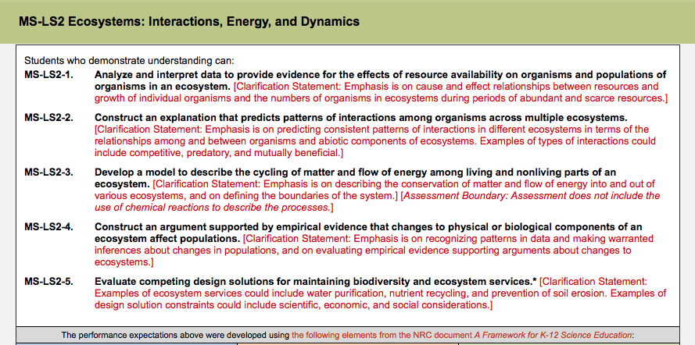
Inside the NGSS Box
What Is Assessed
A collection of several performance expectations describing what students should be able to do at the end of instruction
Performance Expectations
A statement that combines practices, core ideas, and crosscutting concepts to describe how students can show what they have learned
Clarification Statement
A statement that supplies examples or additional clarification to the performance expectation
Engineering Connection (*)
An asterisk indicates that a performance expectation integrates traditional science content with engineering through a practice or core idea.
Assessment Boundary
A statement that provides guidance about the scope of the performance expectation at a particular grade level
Notes:
Clarification statement: Additional information or examples that can be used to better understand the PE.
Assessment Boundary: Provides the scope of the PE. It describes more specifically what is or is not expected of students when they are assessed.
Engineering Connection: PE integrates with engineering through a practice or core idea.

Slide 27
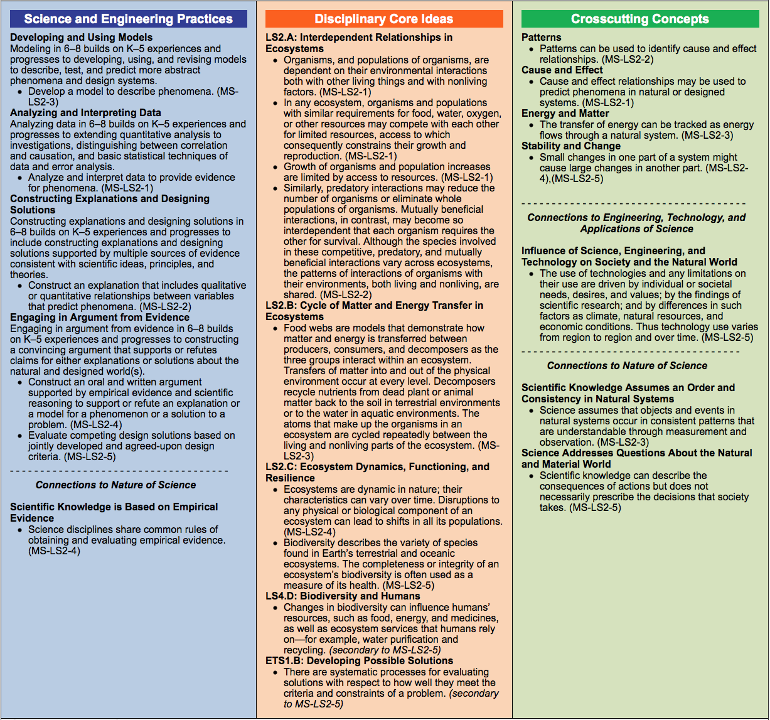
Inside the NGSS Box
Foundation Box
The science and engineering practices, disciplinary core ideas, and crosscutting concepts from the Framework for K–12 Science Education that were used to form the performance expectations
Science and Engineering Practices
Activities that scientists and engineers engage in to either understand the world or solve a problem
Disciplinary Core Ideas
Concepts in science and engineering that have broad importance within and across disciplines, as well as relevance in people’s lives
Crosscutting Concepts
Ideas, such as patterns and cause and effect, that are not specific to any one discipline but cut across them all
Connections to Engineering, Technology, and Applications of Science
These connections are drawn from the disciplinary core ideas for engineering, technology, and applications of science in the Framework.
Connections to Nature of Science
Connections are listed in either the practices or the crosscutting concepts sections of the foundation box.
Notes:
Foundation Box also may include connections to engineering and nature of science.
When using the NGSS to design instruction the foundation box contains the “raw materials” to do so.

Slide 28
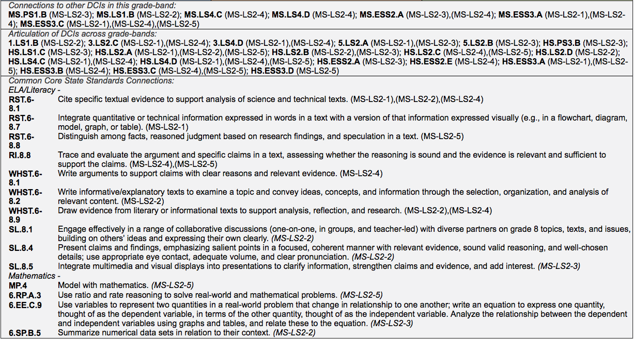
Inside the NGSS Box
Connection Box
Places elsewhere in the NGSS or in the Common Core State Standards that have connections to the performance expectations on this page
Notes:
Connection to other DCIs
Articulation of DCIs across grade levels
Connections to the Common Core

Slide 29
Inside the NGSS Box
Codes for Performance Expectations
Every performance expectation has a unique code, and items in the foundation box and connection box reference this code. In the connections to Common Core, italics indicate a potential connection rather than a required prerequisite connection.
Notes:
Each PE has a code and this code indicates which PE or PEs it goes with.

Slide 30

A Closer Look at a
Performance Expectation
MS-PS1 Matter and Its Interactions
Students who demonstrate understanding can: MS-PS1-5. Develop and use a model to describe how the total number of atoms does not change in a chemical reaction and thus mass is conserved. [Clarification Statement: Emphasis is on law of conservation of matter and on physical models or drawings, including digital forms, that represent atoms.] [Assessment Boundary: Assessment does not include the use of atomic masses, balancing symbolic equations, or intermolecular forces.]
The performance expectations above were developed using the following elements from the NRC document A Framework for K–12 Science Education:
Science and Engineering Practices | Disciplinary Core Ideas | Crosscutting Concepts
Developing and Using Models Modeling in 6–8 builds on K–5 and progresses to developing, using, and revising models to support explanations, describe, test, and predict more abstract phenomena and design systems. Develop a model to describe unobservable mechanisms. (MS-PS1-5) --------------------------------------------- Connections to Nature of Science Science Models, Laws, Mechanisms, and Theories Explain Natural Phenomena Laws are regularities or mathematical descriptions of natural phenomena. (MS-PS1-5) | PS1.B: Chemical Reactions Substances react chemically in characteristic ways. In a chemical process, the atoms that make up the original substances are regrouped into different molecules, and these new substances have different properties from those of the reactants. (MS-PS1-2), (MS-PS1-5), (Note: This disciplinary core idea is also addressed by MS-PS1-3.) The total number of each type of atom is conserved, and thus the mass does not change. (MS-PS1-5) | Energy and Matter Matter is conserved because atoms are conserved in physical and chemical processes. (MS-PS1-5)
Note: Performance expectations combine practices, core ideas, and crosscutting concepts into a single statement of what is to be assessed. They are not instructional strategies or objectives for a lesson.

Slide 31
A Closer Look at a
Performance Expectation
MS-PS1 Matter and Its Interactions
Students who demonstrate understanding can: MS-PS1-5. Develop and use a model to describe how the total number of atoms does not change in a chemical reaction and thus mass is conserved. [Clarification Statement: Emphasis is on law of conservation of matter and on physical models or drawings, including digital forms, that represent atoms.] [Assessment Boundary: Assessment does not include the use of atomic masses, balancing symbolic equations, or intermolecular forces.]
The performance expectations above were developed using the following elements from the NRC document A Framework for K–12 Science Education:
Science and Engineering Practices | Disciplinary Core Ideas | Crosscutting Concepts
Developing and Using Models Modeling in 6–8 builds on K–5 and progresses to developing, using, and revising models to support explanations, describe, test, and predict more abstract phenomena and design systems. Develop a model to describe unobservable mechanisms. (MS-PS1-5) --------------------------------------------- Connections to Nature of Science Science Models, Laws, Mechanisms, and Theories Explain Natural Phenomena Laws are regularities or mathematical descriptions of natural phenomena. (MS-PS1-5) | PS1.B: Chemical Reactions Substances react chemically in characteristic ways. In a chemical process, the atoms that make up the original substances are regrouped into different molecules, and these new substances have different properties from those of the reactants. (MS-PS1-2), (MS-PS1-5), (Note: This disciplinary core idea is also addressed by MS-PS1-3.) The total number of each type of atom is conserved, and thus the mass does not change. (MS-PS1-5) | Energy and Matter Matter is conserved because atoms are conserved in physical and chemical processes. (MS-PS1-5)
Note: Performance expectations combine practices, core ideas, and crosscutting concepts into a single statement of what is to be assessed. They are not instructional strategies or objectives for a lesson.
Notes:
Compare the blue text in the PE to the element in the SEP.
As we talk about this PE always keep in mind that the PE describes what should be assessed, not what should happen during instruction.

Slide 32
A Closer Look at a
Performance Expectation
MS-PS1 Matter and Its Interactions
Students who demonstrate understanding can: MS-PS1-5. Develop and use a model to describe how the total number of atoms does not change in a chemical reaction and thus mass is conserved. [Clarification Statement: Emphasis is on law of conservation of matter and on physical models or drawings, including digital forms, that represent atoms.] [Assessment Boundary: Assessment does not include the use of atomic masses, balancing symbolic equations, or intermolecular forces.]
The performance expectations above were developed using the following elements from the NRC document A Framework for K–12 Science Education:
Science and Engineering Practices | Disciplinary Core Ideas | Crosscutting Concepts
Developing and Using Models Modeling in 6–8 builds on K–5 and progresses to developing, using, and revising models to support explanations, describe, test, and predict more abstract phenomena and design systems. Develop a model to describe unobservable mechanisms. (MS-PS1-5) --------------------------------------------- Connections to Nature of Science Science Models, Laws, Mechanisms, and Theories Explain Natural Phenomena Laws are regularities or mathematical descriptions of natural phenomena. (MS-PS1-5) | PS1.B: Chemical Reactions Substances react chemically in characteristic ways. In a chemical process, the atoms that make up the original substances are regrouped into different molecules, and these new substances have different properties from those of the reactants. (MS-PS1-2), (MS-PS1-5), (Note: This disciplinary core idea is also addressed by MS-PS1-3.) The total number of each type of atom is conserved, and thus the mass does not change. (MS-PS1-5) | Energy and Matter Matter is conserved because atoms are conserved in physical and chemical processes. (MS-PS1-5)
Note: Performance expectations combine practices, core ideas, and crosscutting concepts into a single statement of what is to be assessed. They are not instructional strategies or objectives for a lesson.
Notes:
Compare the orange text in the PE with the elements in the DCI.

Slide 33
A Closer Look at a
Performance Expectation
MS-PS1 Matter and Its Interactions
Students who demonstrate understanding can: MS-PS1-5. Develop and use a model to describe how the total number of atoms does not change in a chemical reaction and thus mass is conserved. [Clarification Statement: Emphasis is on law of conservation of matter and on physical models or drawings, including digital forms, that represent atoms.] [Assessment Boundary: Assessment does not include the use of atomic masses, balancing symbolic equations, or intermolecular forces.]
The performance expectations above were developed using the following elements from the NRC document A Framework for K–12 Science Education:
Science and Engineering Practices | Disciplinary Core Ideas | Crosscutting Concepts
Developing and Using Models Modeling in 6–8 builds on K–5 and progresses to developing, using, and revising models to support explanations, describe, test, and predict more abstract phenomena and design systems. Develop a model to describe unobservable mechanisms. (MS-PS1-5) --------------------------------------------- Connections to Nature of Science Science Models, Laws, Mechanisms, and Theories Explain Natural Phenomena Laws are regularities or mathematical descriptions of natural phenomena. (MS-PS1-5) | PS1.B: Chemical Reactions Substances react chemically in characteristic ways. In a chemical process, the atoms that make up the original substances are regrouped into different molecules, and these new substances have different properties from those of the reactants. (MS-PS1-2), (MS-PS1-5), (Note: This disciplinary core idea is also addressed by MS-PS1-3.) The total number of each type of atom is conserved, and thus the mass does not change. (MS-PS1-5) | Energy and Matter Matter is conserved because atoms are conserved in physical and chemical processes. (MS-PS1-5)
Note: Performance expectations combine practices, core ideas, and crosscutting concepts into a single statement of what is to be assessed. They are not instructional strategies or objectives for a lesson.
Notes:
Compare the green text to the element in the CCC

Slide 34
Save the Penguins Part 2: Looking for Evidence of the Three Dimensions
Did students have opportunities to engage in three-dimensional learning
to explain phenomena or
design solutions?

Slide 35

Evidence From the Immersion Experience
Evidence
I can see it, point to it in a
lesson or unit, highlight it, or
quote it directly from what
is written.

Slide 36
Save The Penguins
Table Discussion
As a group, discuss each dimension. Share whether or not you found evidence of the elements of each dimension in the immersion experience.
  Connect evidence from the activity to the elements of the dimensions in your discussion.
  Remember: The evidence shared is focused only on STUDENTS using the three dimensions to make sense of phenomena or design solutions to problems.
Notes:
Use the graphic organizer in your binder

Slide 37
PEs Combine Particular Elements of the Three Dimensions
4-ESS2 Earth’s Systems
Students who demonstrate understanding can: 4-ESS2-1. Make observations and/or measurements to provide evidence of the effects of weathering on the rate of erosion by water, ice, wind or vegetation. [Clarification Statement: Examples of variables to test could include angle of slope in the downhill movement of water, amount of vegetation, speed of wind, relative rate of deposition, cycles of freezing and thawing of water, cycles of heating and cooling, and volume of water flow.] [Assessment Boundary: Assessment is limited to a single form of weathering or erosion].
Science and Engineering Practices | Disciplinary Core Ideas | Crosscutting Concepts
Planning and Carrying Out Investigations Planning and carrying out investigations to answer questions or test solutions to problems in 3–5 builds on K–2 experiences and progresses to include investigations that control variables and provide evidence to support explanations or design solutions. Make observations and/or measurements to produce data to serve as the basis for evidence for an explanation of phenomena. | ESS2.A: Earth Materials and Systems Rainfall helps to shape the land and affects the types of things found in a region. Water, ice, wind, living organisms, and gravity break down rocks, soils, and sediments into smaller particles and move them around. ESS2.E: Biogeology Living things affect the physical characteristics of their regions | Cause and Effect Cause and effect relationships are routinely identified, tested, and used to explain change.

Slide 38
Instruction Can Use Those
Same Elements
MS-PS1 Matter and Its Interactions
Students who demonstrate understanding can: MS-PS1-1. Develop a model to describe that matter is made of particles too small to be seen. [Clarification Statement: Examples of evidence could include adding air to expand a basketball, compressing air in a syringe, dissolving sugar in water, and evaporating salt water.] [Assessment Boundary: Assessment does not include the atomic-scale mechanism of evaporation and condensation or defining the unseen particles.]
Science and Engineering Practices | Disciplinary Core Ideas | Crosscutting Concepts
Planning and Carrying Out Investigations Planning and carrying out investigations to answer questions or test solutions to problems in 3–5 builds on K–2 experiences and progresses to include investigations that control variables and provide evidence to support explanations or design solutions. Make observations and/or measurements to produce data to serve as the basis for evidence for an explanation of phenomena. | ESS2.A: Earth Materials and Systems Rainfall helps to shape the land and affects the types of things found in a region. Water, ice, wind, living organisms, and gravity break down rocks, soils, and sediments into smaller particles and move them around. ESS2.E: Biogeology Living things affect the physical characteristics of their regions. | Cause and Effect Cause and effect relationships are routinely identified, tested, and used to explain change.

Slide 39
Instruction Can Use Those
Same Elements …
MS-PS1 Matter and Its Interactions
Students who demonstrate understanding can: MS-PS1-1. Develop a model to describe that matter is made of particles too small to be seen. [Clarification Statement: Examples of evidence could include adding air to expand a basketball, compressing air in a syringe, dissolving sugar in water, and evaporating salt water.] [Assessment Boundary: Assessment does not include the atomic-scale mechanism of evaporation and condensation or defining the unseen particles.]
 | Disciplinary Core Ideas
 | ESS2.A: Earth Materials and Systems Rainfall helps to shape the land and affects the types of things found in a region. Water, ice, wind, living organisms, and gravity break down rocks, soils, and sediments into smaller particles and move them around.

Slide 40
But Should Also
Mix and Match Elements
MS-PS1 Matter and Its Interactions
Students who demonstrate understanding can: MS-PS1-1. Develop a model to describe that matter is made of particles too small to be seen. [Clarification Statement: Examples of evidence could include adding air to expand a basketball, compressing air in a syringe, dissolving sugar in water, and evaporating salt water.] [Assessment Boundary: Assessment does not include the atomic-scale mechanism of evaporation and condensation or defining the unseen particles.]
 | Disciplinary Core Ideas
 | ESS2.A: Earth Materials and Systems Rainfall helps to shape the land and affects the types of things found in a region. Water, ice, wind, living organisms, and gravity break down rocks, soils, and sediments into smaller particles and move them around.
MS-PS1 Matter and Its Interactions
Students who demonstrate understanding can: MS-PS1-1. Develop a model to describe that matter is made of particles too small to be seen. [Clarification Statement: Examples of evidence could include adding air to expand a basketball, compressing air in a syringe, dissolving sugar in water, and evaporating salt water.] [Assessment Boundary: Assessment does not include the atomic-scale mechanism of evaporation and condensation or defining the unseen particles.]
 | Disciplinary Core Ideas
 | PS1.A: Structure and Properties of Matter Matter of any type can be subdivided into particles that are too small to see, but even then the matter still exists and can be detected by other means. A model showing that gases are made from matter particles that are too small to see and are moving freely around in space can explain many observations, including the inflation and shape of a balloon and the effects of air on larger particles or objects.
 |  | Crosscutting Concepts
 |  | Patterns Patterns of change can be used to make predictions.
 |  | Crosscutting Concepts
 |  | Cause and Effect: Mechanism and Prediction Cause and effect relationships are routinely identified, tested, and used to explain change.
 |  | Crosscutting Concepts
 |  | Scale, Proportion, and Quantity Natural objects and/or observable phenomena exist from the very small to the immensely large or from very short to very long time periods.
 |  | Crosscutting Concepts
 |  | Systems and System Models A system can be described in terms of its components and their interactions.
 |  | Crosscutting Concepts
 |  | Energy and Matter: Flows, Cycles, and Conservation Matter is made of particles.
 |  | Crosscutting Concepts
 |  | Structure and Function Different materials have different substructures, which can sometimes be observed.
 |  | Crosscutting Concepts
 |  | Stability and Change Change is measured in terms of differences over time and may occur at different rates.
Science and Engineering Practices
Developing and Using Models Modeling in 3–5 builds on K–2 experiences and progresses to building and revising simple models and using models to represent events and design solutions. Use models to describe phenomena.
Science and Engineering Practices
Planning and Carrying Out Investigations Planning and carrying out investigations to answer questions or test solutions to problems in 3–5 builds on K–2 experiences and progresses to include investigations that control variables and provide evidence to support explanations or design solutions. Make observations and/or measurements to produce data to serve as the basis for evidence for an explanation of a phenomenon or test a design solution.
Science and Engineering Practices
Using Mathematics and Computational Thinking Mathematical and computational thinking in 3–5 builds on K–2 experiences and progresses to extending quantitative measurements to a variety of physical properties and using computation and mathematics to analyze data and compare alternative design solutions. Organize simple data sets to reveal patterns that suggest relationships.
Science and Engineering Practices
Constructing Explanations and Designing Solutions Constructing explanations and designing solutions in 3–5 builds on K–2 experiences and progresses to the use of evidence in constructing explanations that specify variables that describe and predict phenomena and in designing multiple solutions to design problems. Identify the evidence that supports particular points in an explanation.
Science and Engineering Practices
Engaging in Argument from Evidence Engaging in argument from evidence in 3–5 builds on K–2 experiences and progresses to critiquing the scientific explanations or solutions proposed by peers by citing relevant evidence about the natural and designed world(s). Compare and refine arguments based on an evaluation of the evidence presented.
Science and Engineering Practices
Obtaining, Evaluating, and Communicating Information Obtaining, evaluating, and communicating information in 3–5 builds on K–2 experiences and progresses to evaluating the merit and accuracy of ideas and methods. Communicate scientific and/or technical information orally and/or in written formats, including various forms of media and may include tables, diagrams, and charts.
Science and Engineering Practices
Asking Questions and Defining Problems Asking questions and defining problems in 3–5 builds on K–2 experiences and progresses to specifying qualitative relationships. Ask questions that can be investigated and predict reasonable outcomes based on patterns such as cause and effect relationships.
Science and Engineering Practices
Analyzing and Interpreting Data Analyzing data in 3–5 builds on K–2 experiences and progresses to introducing quantitative approaches to collecting data and conducting multiple trials of qualitative observations. When possible and feasible, digital tools should be used. Analyze and interpret data to make sense of phenomena, using logical reasoning, mathematics, and/or computation.

